Slide 1
Computer Networks
Week 4

Slide 2
Learning Objectives
What is a Computer Network?
Goals of Computer networks
Computer Network Devices
VPN vs Client/Server Network
Types of Computer Networks Architecture
Internet vs internet
Intranet vs Extranet
Network Protocols

Slide 3
Computer Networks
A computer network is a system in which multiple computers are connected to each other to share information and resources. A simple computer network can be built only from two computers while a complex computer network can be built from several thousand computers.
It is a collection of interconnected devices that share resources and information. These devices can include computers, servers, printers, and other hardware. Networks allow for efficient data exchange, enabling various applications such as email, file sharing, and internet browsing.

Slide 4
Goals of Computer Networks
Resource Sharing:
High Reliability:
Inter-Process Communication:
Flexible Access:
Security
Performance
Scalability
Many organization have a substantial number of computers in operations, which are located apart. Ex. A group of office workers can share a common printer, fax, modem, scanner, etc. .
If there are alternate sources of supply, all files could be replicated on two or more machines. If one of them is not available, due to hardware failure, the other copies could be used.
Network users, located geographically apart, may converse in an interactive session through the network. In order to permit this, the network must provide almost error-free communications.
Files can be accessed from any computer in the network. The project can be begun on one computer and finished on another.
Computer networks must be secure to protect against unauthorized access, data breaches, and other security threats. This includes implementing measures such as firewalls, antivirus software, and encryption to ensure the confidentiality, integrity, and availability of data.
Computer networks must provide high performance and low latency to ensure that applications and services are responsive and available when needed. This requires optimizing network infrastructure, bandwidth utilization, and traffic management.
Computer networks must be designed to scale up or down as needed to accommodate changes in the number of users, devices, and data traffic.

Slide 5
Types of Computer Network Architecture
Client-Server Architecture:
Peer-to-Peer Architecture:
A type of computer network architecture in which nodes can be servers or clients. The server node can manage the client node behaviors.
P2P (Peer-to-Peer) Architecture, is not based on the concept of a central server. Each device is free for working as either client or server.

Slide 6
Terminologies of Computer Networks
Nodes:
Protocol:
Topology:
IP Address:
DNS:
Firewall:
Nodes are devices that are connected to a network. These can include computers, servers, printers, routers, switches, and other devices.
A protocol is a set of rules and standards that govern how data is transmitted over a network. Examples of protocols include TCP/IP, HTTP, and FTP.
Network topology refers to the physical and logical arrangement of nodes on a network. The common network topologies include bus, star, ring, mesh, and tree.
An IP address is a unique numerical identifier that is assigned to every device on a network. IP addresses are used to identify devices and enable communication between them.
The Domain Name System (DNS) is a protocol that is used to translate human-readable domain names (such as www.google.com) into IP addresses that computers can understand.
A firewall is a security device that is used to monitor and control incoming and outgoing network traffic. Firewalls are used to protect networks from unauthorized access and other security threats.

Slide 7
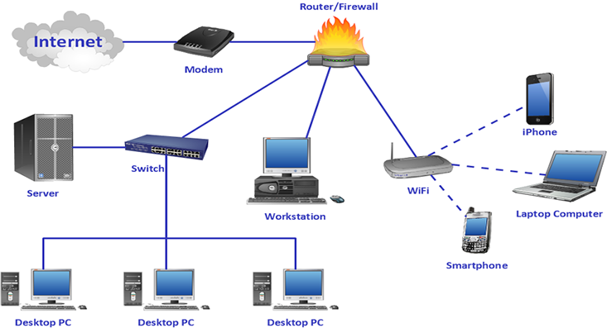
Computer Network Devices

Slide 8
NIC and MAC
The Media Access Control (MAC) address or physical address is encoded on the network card chip which is assigned by the IEEE to identify a network card uniquely. The MAC address is stored in the PROM (Programmable read-only memory).
There are two types of NIC:
Wired NIC: The Wired NIC is present inside the motherboard. Cables and connectors are used with wired NIC to transfer data.
Wireless NIC: The wireless NIC contains the antenna to obtain the connection over the wireless network. For example, laptop computer contains the wireless NIC
A NIC (Network Interface Card) is the physical hardware component that allows a device to connect to a network, while a MAC (Media Access Control) address is the unique, permanent identifier embedded in that NIC.
.

Slide 9
Hub
A Hub is a hardware device that divides the network connection among multiple devices. When computer requests for some information from a network, it first sends the request to the Hub through cable. Hub will broadcast this request to the entire network. All the devices will check whether the request belongs to them or not. If not, the request will be dropped.
The process used by the Hub consumes more bandwidth and limits the amount of communication. Nowadays, the use of hub is obsolete, and it is replaced by more advanced computer network components such as Switches, Routers.
.

Slide 10
Switch
A switch is a hardware device that connects multiple devices on a computer network.
A Switch contains more advanced features than Hub. The Switch contains the updated table that decides where the data is transmitted or not.
Switch delivers the message to the correct destination based on the physical address present in the incoming message.
A Switch does not broadcast the message to the entire network like the Hub. It determines the device to whom the message is to be transmitted.
Therefore, we can say that switch provides a direct connection between the source and destination. It increases the speed of the network.
.

Slide 11
Router
A router is a hardware device which is used to connect a LAN with an internet connection. It is used to receive, analyze and forward the incoming packets to another network. A router works in a Layer 3 (Network layer) of the Open System Interconnection (OSI) Reference model. A router forwards the packet based on the information available in the routing table. It determines the best path from the available paths for the transmission of the packet.
Advantages Of Router:
Security: The information which is transmitted to the network will traverse the entire cable, but the only specified device which has been addressed can read the data.
Reliability: If the server has stopped functioning, the network goes down, but no other networks are affected that are served by the router.
Performance: Router enhances the overall performance of the network. Suppose there are 24 workstations in a network generates a same amount of traffic. This increases the traffic load on the network. Router splits the single network into two networks of 12 workstations each, reduces the traffic load by half.
.

Slide 12
Modem
It stands for Modulator/Demodulator. It converts the digital data into an analog signal over the telephone lines.
A modem is not integrated with the motherboard rather than it is installed on the PCI slot found on the motherboard.
Based on the differences in speed and transmission rate, a modem can be classified in the following categories:
Standard PC modem or Dial-up modem
Cellular Modem
Cable modem
A modem is a hardware device that allows the computer to connect to the internet over the existing telephone line.
.

Slide 13
Types of Computer Networks
Personal Area Network (PAN)
Metropolitan Area Network (MAN)
Wide Area Network (WAN)
Campus Area Network (CAN)
Wireless Local Area Network (WLAN)
Storage Area Network (SAN)
Enterprise Private Area Network
Local Area Network (LAN)
Virtual Private Network (VPN)

Slide 14
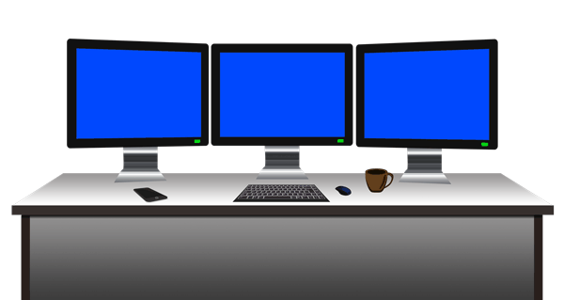

Personal Area Network (PAN)
Personal Area Network (PAN)

Slide 15
Personal Area Network (PAN)
Personal Area Network (PAN)
PAN is the most basic type of computer network.
This network is restrained to a single person, that is, communication between the computer devices is centred only to an individual’s work space.
PAN offers a network range of 10 meters from a person to the device providing communication.
Examples of PAN are USB, computer, phone, tablet, printer, PDA, etc.

Slide 16
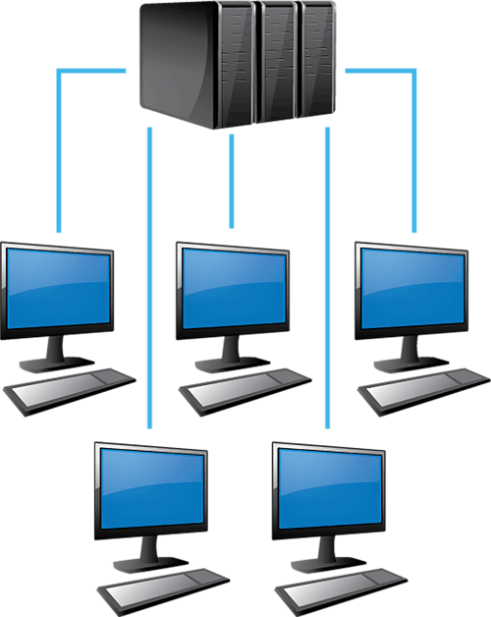
Local Area Network (LAN)
Local Area Network (LAN)

Slide 17
Local Area Network (LAN)
Local Area Network (LAN)
LAN is the most frequently used network.
Examples of LAN are networking in a home, school, library, laboratory, college, office, etc.
A LAN is a computer network that connects computers together through a common communication path, contained within a limited area, that is, locally.
A LAN encompasses two or more computers connected over a server. The two important technologies involved in this network are Ethernet and Wi-fi.

Slide 18

Wide Area Network (WAN)
Wide Area Network (WAN)

Slide 19
Wide Area Network (WAN)
Wide Area Network (WAN)
WAN is a type of computer network that connects computers over a large geographical distance through a shared communn path.
The most common example of WAN is the Internet.
It is not restrained to a single location but extends over many locations.
WAN can also be defined as a group of local area networks that communicate with each other.

Slide 20
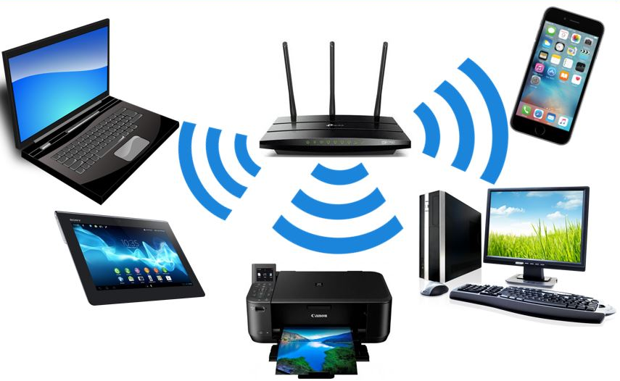
Wireless Local Area Network (WLAN)
Wireless Local Area Network (WLAN)

Slide 21
Wireless Local Area Network (WLAN)
Wireless Local Area Network (WLAN)
WLAN is a type of computer network that acts as a local area network but makes use of wireless network technology.
The most common example of WLAN is Wi-Fi.
This network doesn’t allow devices communicating over physical cables like in LAN, but allows devices to communicate wirelessly.

Slide 22
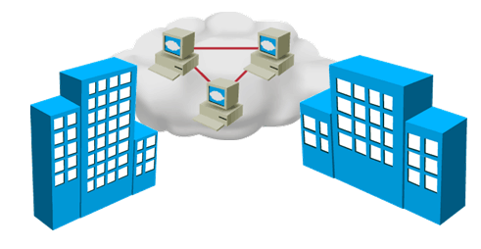
Metropolitan Area Network (MAN)
Metropolitan Area Network (MAN)

Slide 23
Metropolitan Area Network (MAN)
Metropolitan Area Network (MAN)
A MAN is larger than a LAN but smaller than a WAN.
Examples of MAN are networking in towns, cities, a single large city, large area within multiple buildings, etc.
This is the type of computer network that connects computers over a geographical distance through a shared communication path over a city, town or metropolitan area.

Slide 24
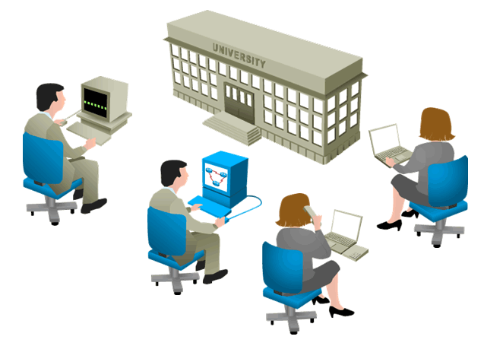
Campus Area Network (CAN)
Campus Area Network (CAN)

Slide 25
Campus Area Network (CAN)
Campus Area Network (CAN)
CAN is bigger than a LAN but smaller than a MAN.
Examples of CAN are networks that cover schools, colleges, buildings, etc.
This is a type of computer network which is usually used in places like a school or college.
This network covers a limited geographical area that is, it spreads across several buildings within the campus.

Slide 26
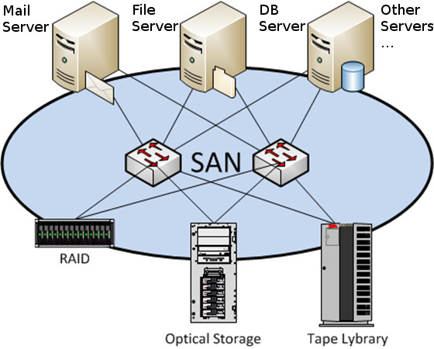
Storage Area Network (SAN)
Storage Area Network (SAN)

Slide 27
Storage Area Network (SAN)
Storage Area Network (SAN)
SAN is a type of computer network that is high speed and connects groups of storage devices to several servers.
Examples of SAN are a network of disks accessed by a network of servers.
This network does not depend on LAN or WAN. Instead, a SAN moves the storage resources from the network to its own high-powered network.
A SAN provides access to block-level data storage.

Slide 28
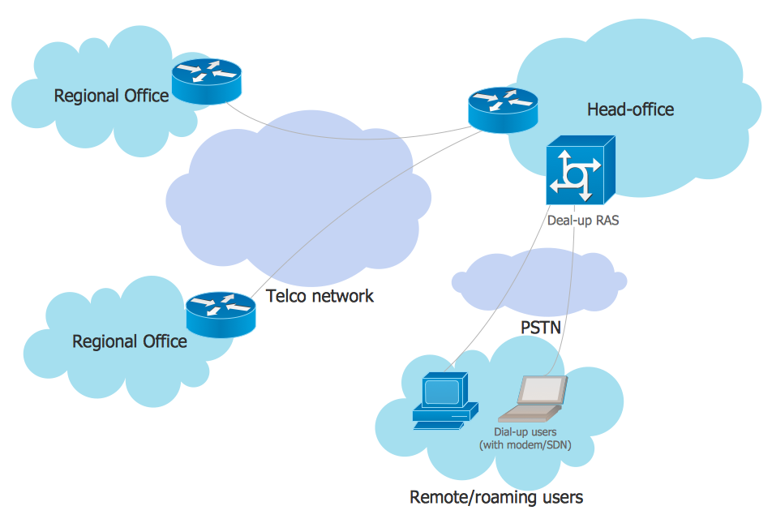
Enterprise Private Network (EPN)
Enterprise Private Network (EPN)

Slide 29
Enterprise Private Network (EPN)
Enterprise Private Network (EPN)
An enterprise private network is mainly set up to share computer resources.
An EPN helps enterprise companies with a number of disparate offices connect those offices to each in a secure way over a network.
EPN is a type of computer network mostly used by businesses that want a secure connection over various locations to share computer resources.

Slide 30
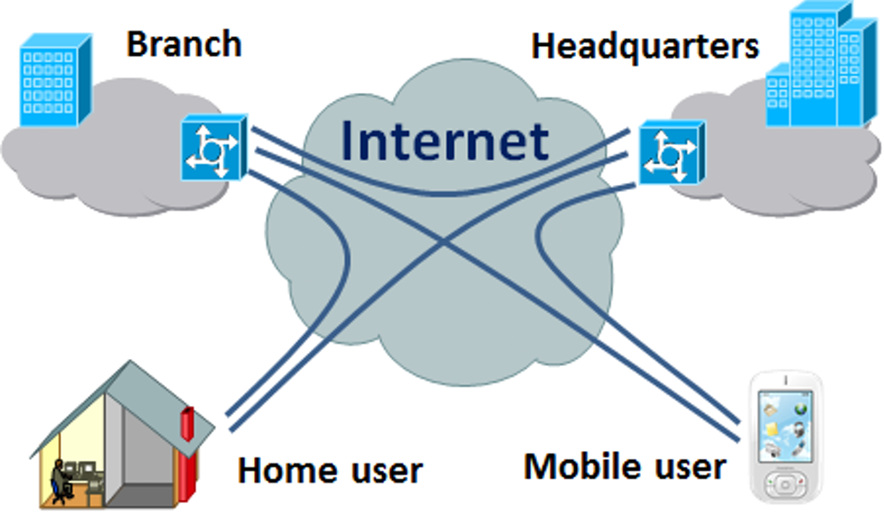

Virtual Private Network (VPN)
Virtual Private Network (VPN)

Slide 31
Virtual Private Network (VPN)
Virtual Private Network (VPN)
A VPN is a type of computer network that extends a private network across the internet and lets the user send and receive data as if they were connected to a private network even though they are not.
Through a virtual point to point connection users can access a private network remotely.
VPN protects you from malicious sources by operating as a medium that gives you protected network connection.

Slide 32
Network Protocols
Transmission Control Protocol/Internet Protocol (TCP/IP):
Hypertext Transfer Protocol (HTTP) and HTTPS:
Simple Mail Transfer Protocol (SMTP):
File Transfer Protocol (FTP):
TCP/IP is the foundational protocol suite of the internet, enabling reliable communication. It ensures data is delivered reliably and in order and IP routes data packets to their destination based on IP addresses.
HTTP and HTTPS protocols used for transmitting web pages. In HTTP communication is unsecured and in HTTPS secured communication using SSL/TLS encryption.
SMTP protocol is used to send email. SMTP protocol works with other protocols like POP3 and IMAP for email retrieval.
FTP protocol used for transferring files between computers. Includes commands for uploading, downloading, and managing files on a remote server.

Slide 33

Internet vs internet
Internet
internet

Slide 34
Internet
The Internet is the largest computer network ever created by mankind. It interconnects thousands of millions of computing devices including PCs, Laptops, Workstations, Server, Smartphones, tablets, TVs, Webcams, Environmental devices, Automobiles, Security cameras and many mores.

Slide 35
internet
The internet sounds similar to Internet, but it is different. The word Internet starts with capital I, while the word internet begins with small i.
Any group of network which is connected with external network through a gateway such as Border Gateway Protocol (BGP) is considered as internet.
Usually this type of network is setup to provide the connectivity between two companies.

Slide 36
Intranet vs Extranet
Intranet
Extranet

Slide 37
Intranet
Intranet is a computer network which is controlled and administered by a single entity such as company or organization.
In Intranet, external users are not allowed to connect.
Usually in this network, proper authorization is required to access any resources.
Further each access is monitored and logged to ensure that only authorized users get access.

Slide 38
Extranet
An Extranet is an extended Intranet where external users are allowed to access a small portion of network.
Normally this access is filtered and secured by several security implementations on both hardware and software levels.

Slide 39
VPN vs Client/Server
VPN
Client/Server

Slide 40
Virtual Private Network (VPN)
VPN is a mechanism of employing encryption, authentication, and integrity protection to use a public network as if it is a private network. It offers a high amount of security and allows users to remotely access private networks.
A Virtual Private Network is a way to extend a private network using a public network such as the Internet. The name only suggests that it is a “Virtual Private Network”, i.e. user can be part of a local network sitting at a remote location.

Slide 41
Client/Server Network
In a client/server network a dedicated computer known as server provides sharing resources. All other computers know as clients are used to access the shared resources.
This type of network is commonly used in company environment. It provides great security features but requires special hardware and software to setup.
In the client-server architecture, when the client computer sends a request for data to the server through the internet, the server accepts the requested process and delivers the data packets requested back to the client

Slide 42
Benefits of Computer Networks
Easy Sharing of Data & Hardware Resources
Easy Sharing of Software
Easy to Decentralize Data Processing
Easy to Communicate
Improve Storage Efficiency and Volume
Cut Cost on Software
Secure Valuable Information

Slide 43
Computer Network Security
Firewalls:
Encryption:
Intrusion Detection Systems (IDS):
Access Control:
Regular Updates and Patching:
Devices or software that monitor and control incoming and outgoing network traffic based on security rules.
The process of encoding data to prevent unauthorized access. Commonly used in VPNs, HTTPS, and secure email.
Tools that monitor network traffic for suspicious activity and potential threats.
Mechanisms that restrict access to network resources based on user identity and role.
Keeping software and hardware up to date to protect against vulnerabilities.

